Slide 1
K-means
CSC 466
Paul Anderson Figures for examples from Auton Lab at CMU

Slide 2
https://www.google.com/url?sa=i&source=images&cd=&ved=2ahUKEwi1-cfJ6vTlAhXEIDQIHVuLAB0QjRx6BAgBEAQ&url=https%3A%2F%2Fwww.researchgate.net%2Ffigure%2FSupervised-and-unsupervised-machine-learning_fig2_325867536&psig=AOvVaw3u2Dr8SKrMEPc5XbqNOEbz&ust=1574203325663897

Slide 3
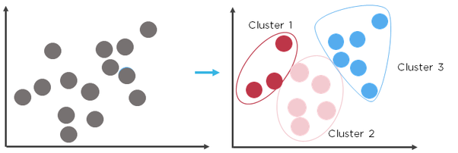
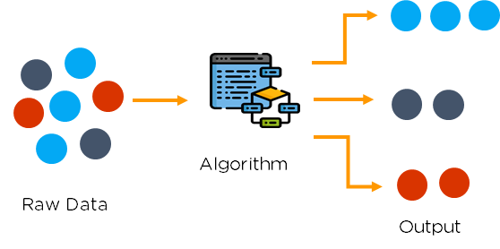
Clustering
https://qph.fs.quoracdn.net/main-qimg-0e5dd3bd8e7c605b0429b0c59d635b52
https://qph.fs.quoracdn.net/main-qimg-ccff5b1acc4e4c8bf697ffce489f6d19

Slide 4
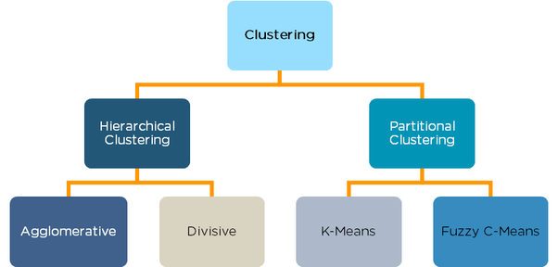

Slide 5
K-Means Example

Slide 6
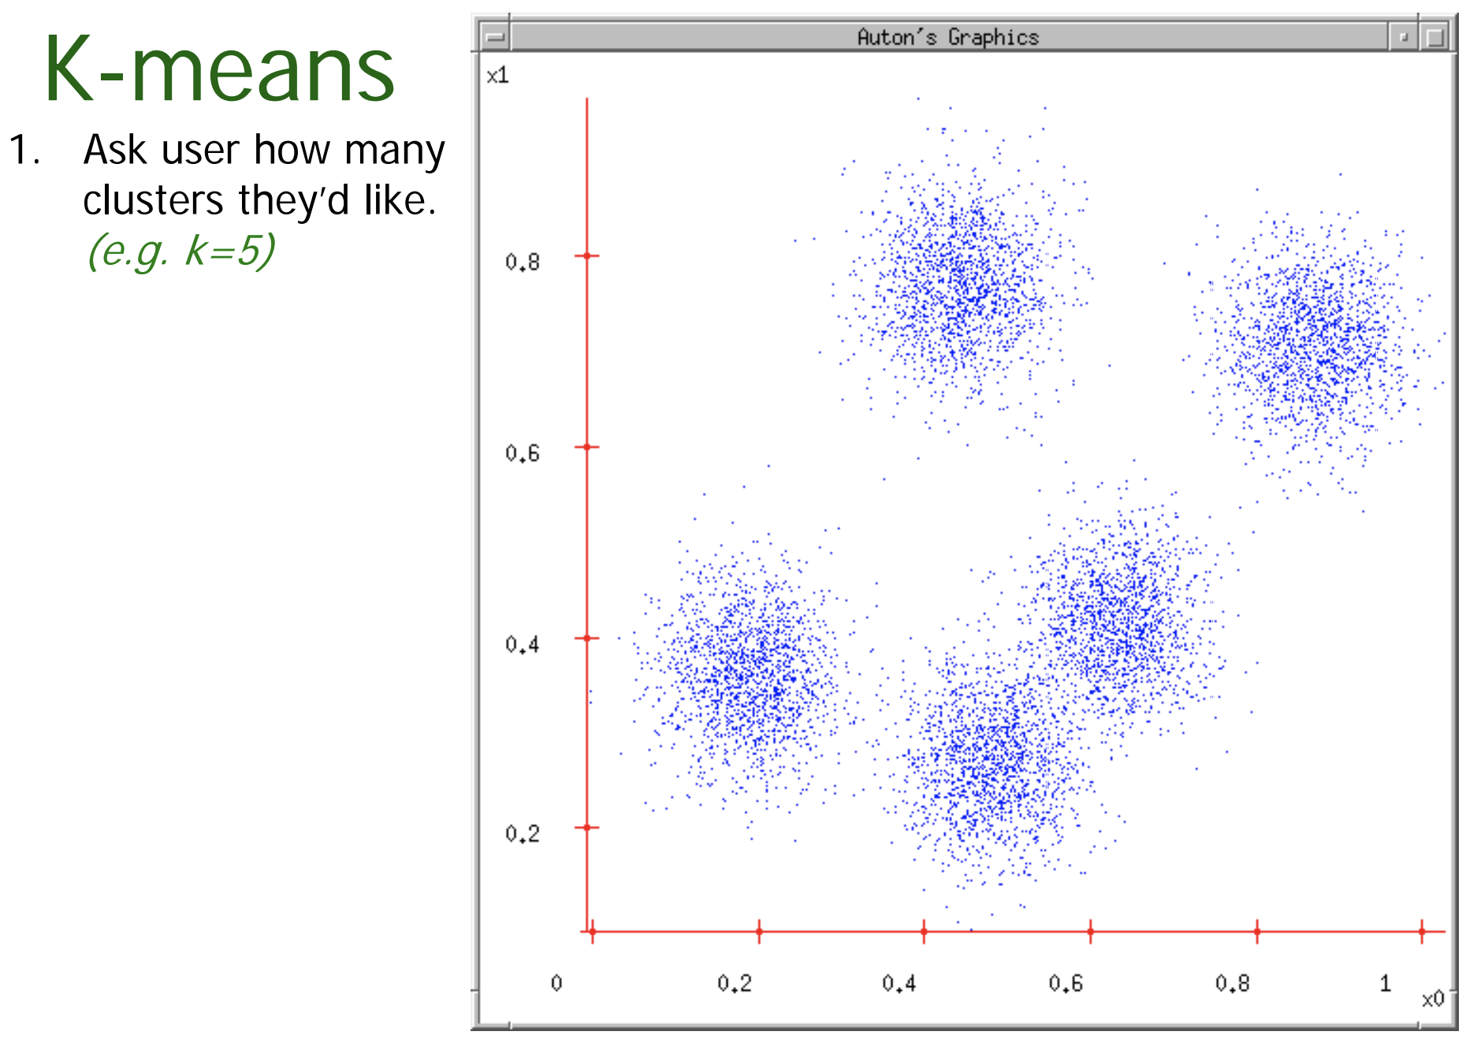

Slide 7
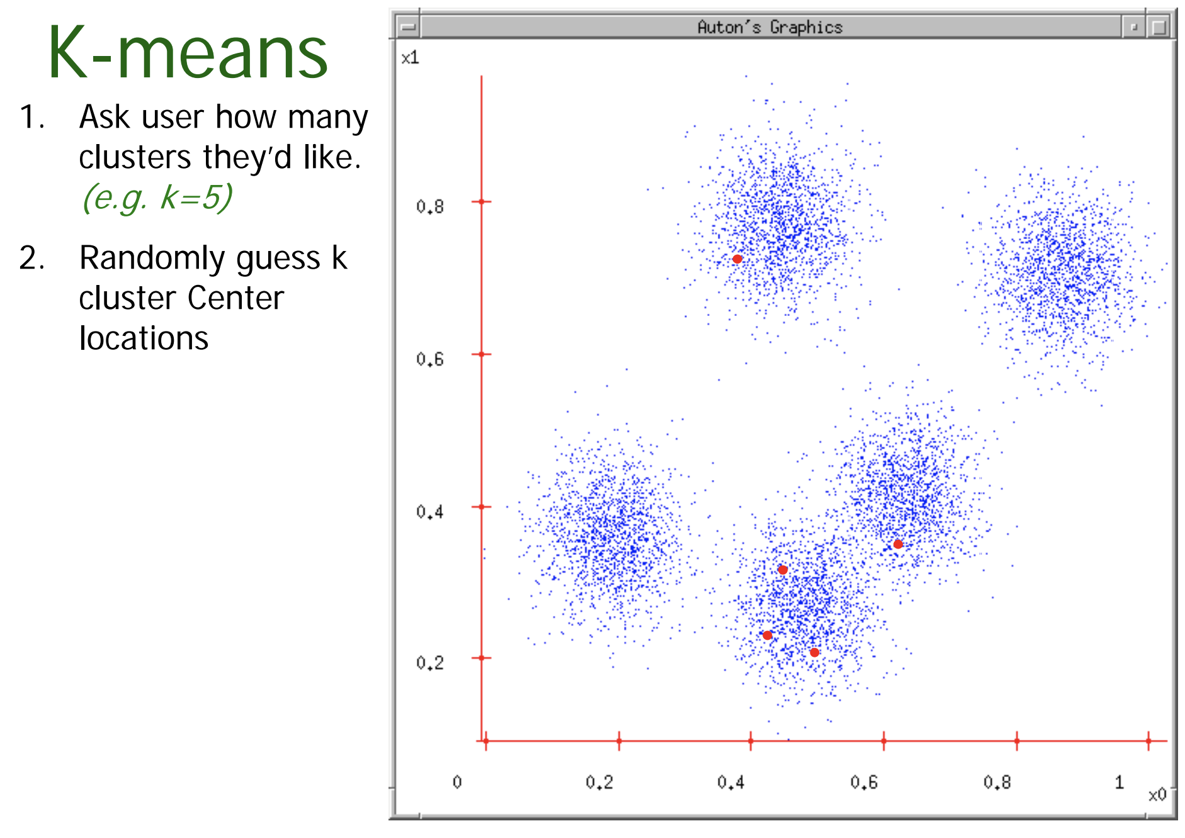

Slide 8
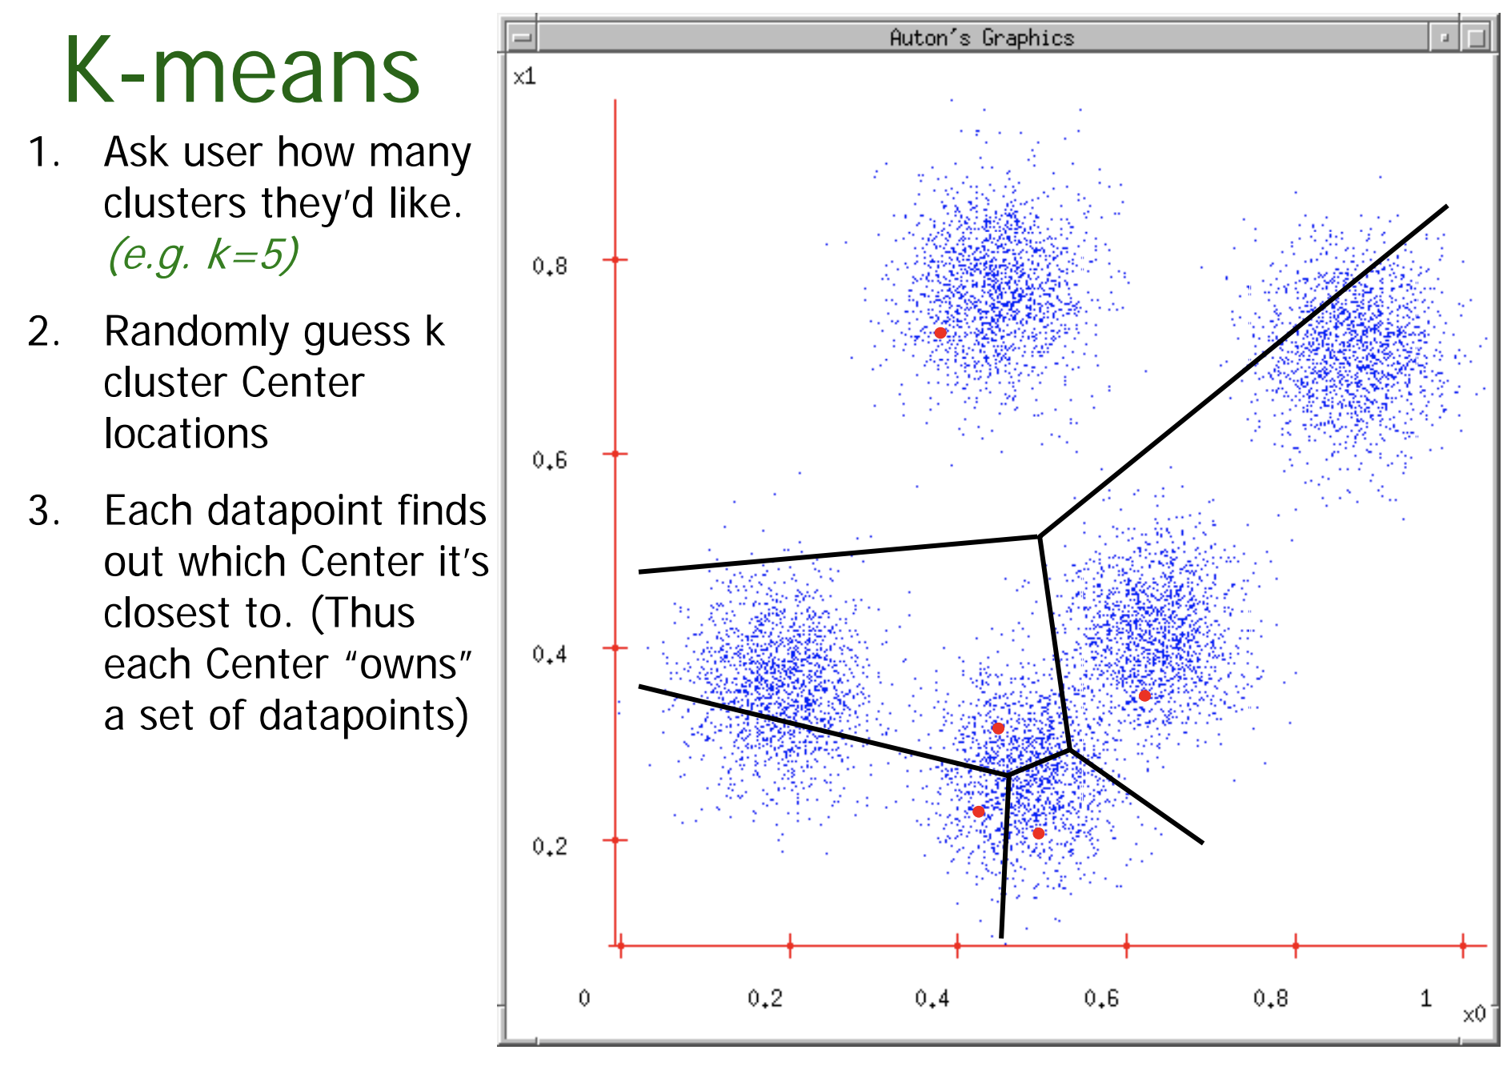

Slide 9
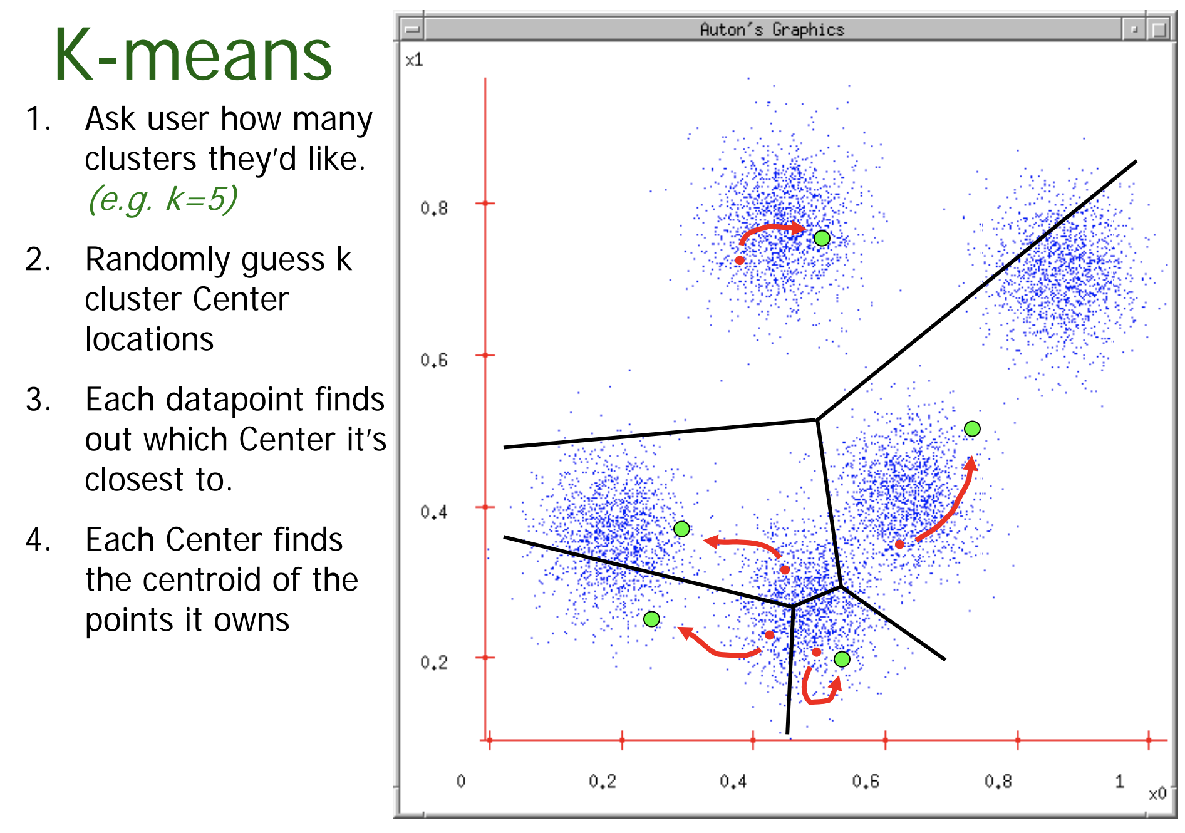

Slide 10
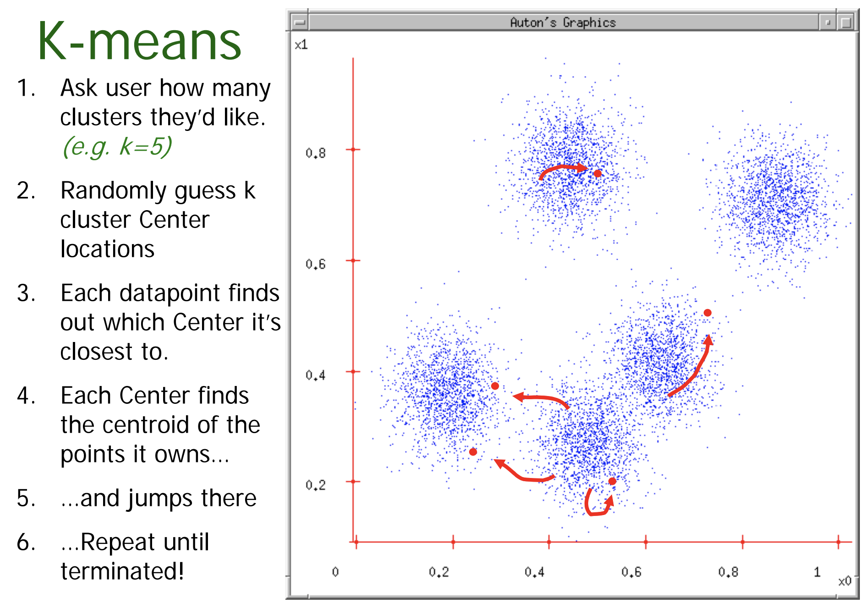

Slide 11
Simple algorithm but some deeper questions
What is it trying to optimize?
Are we sure it will terminate?
Are we sure it will find an optimal clustering?
How should we start it?
How could we automatically choose the number of centers?

Slide 12
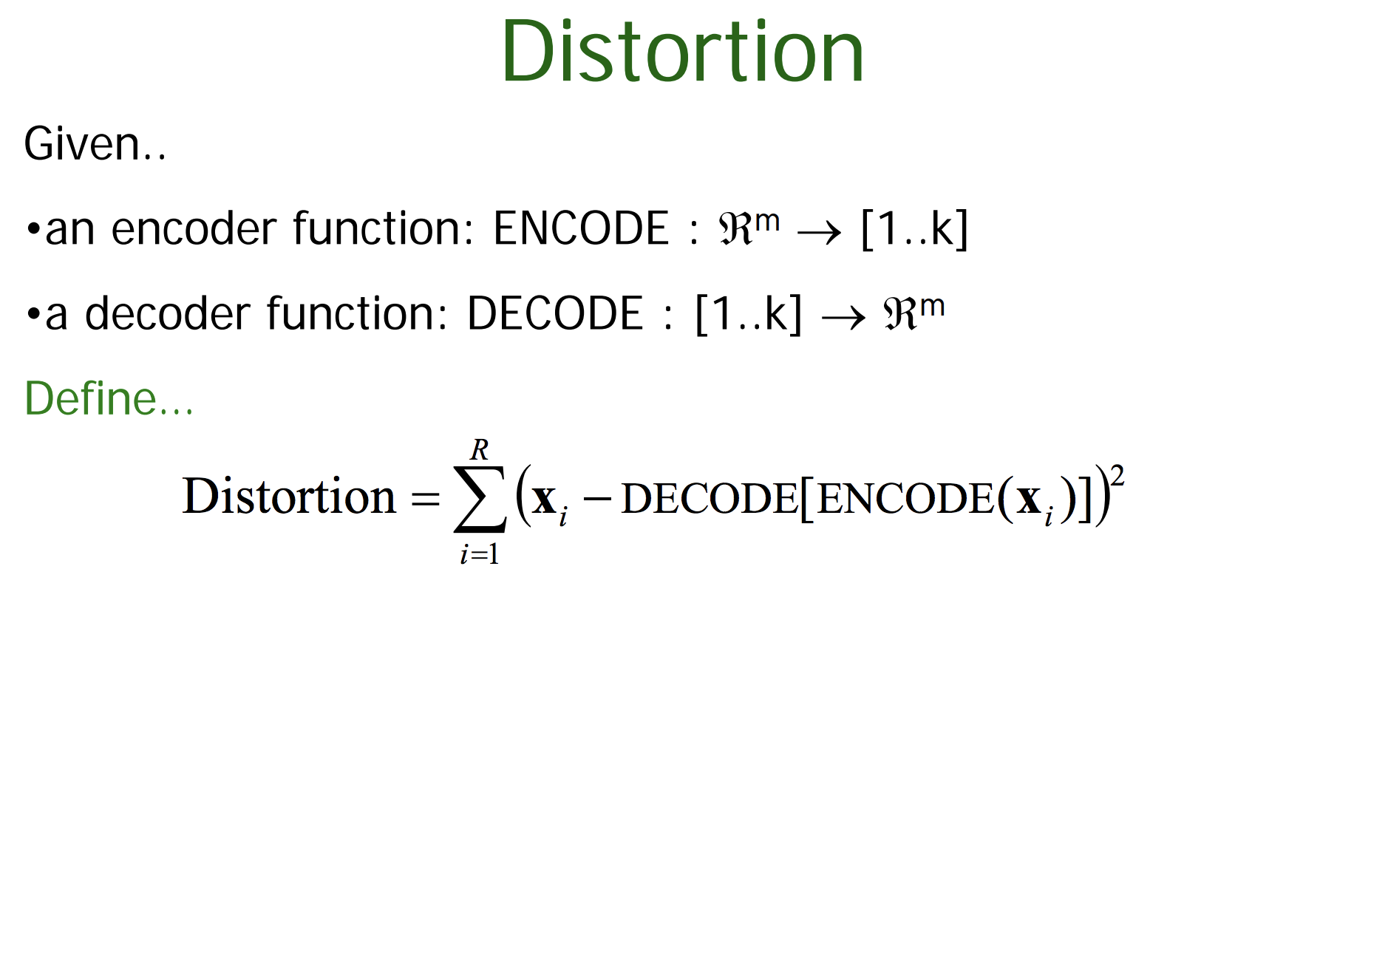

Slide 13
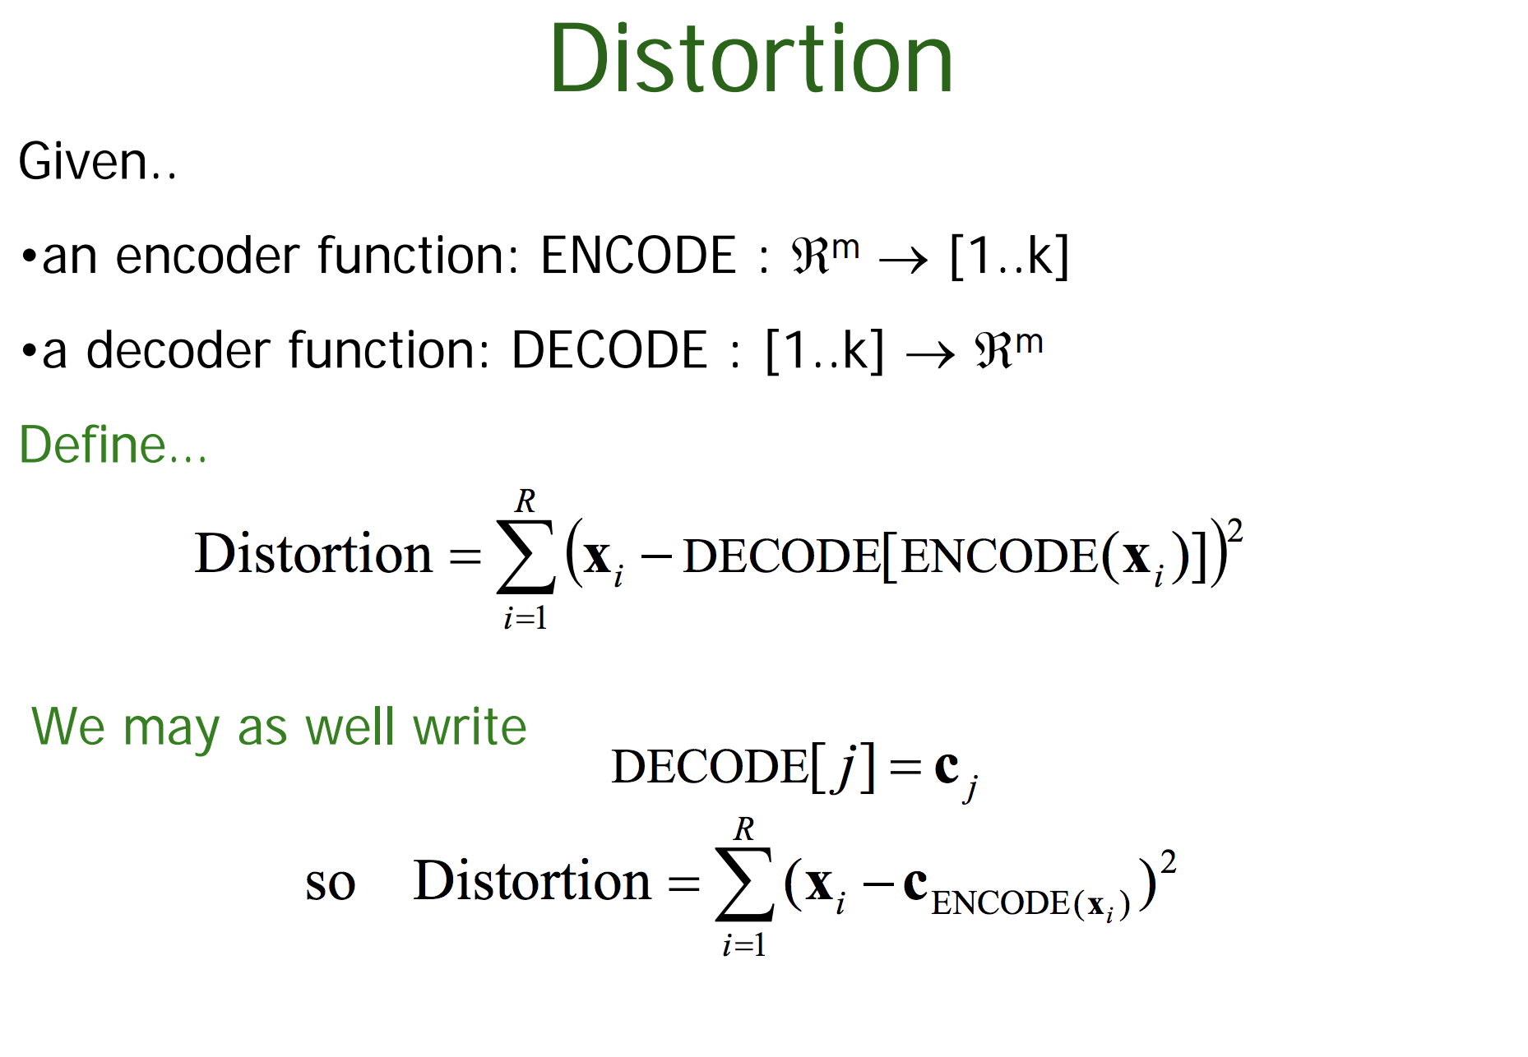

Slide 14
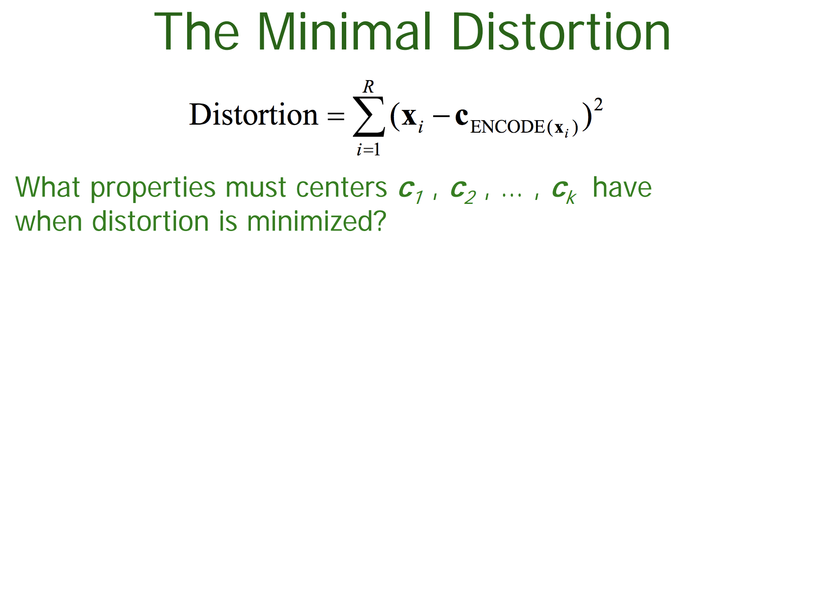

Slide 15
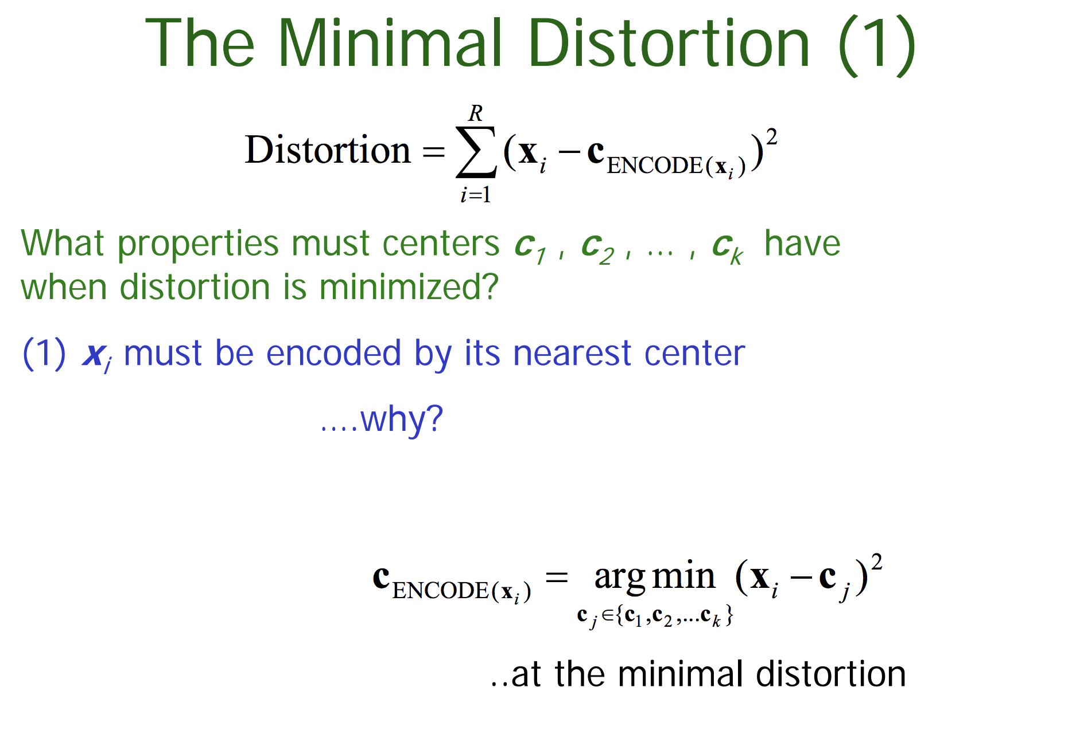

Slide 16
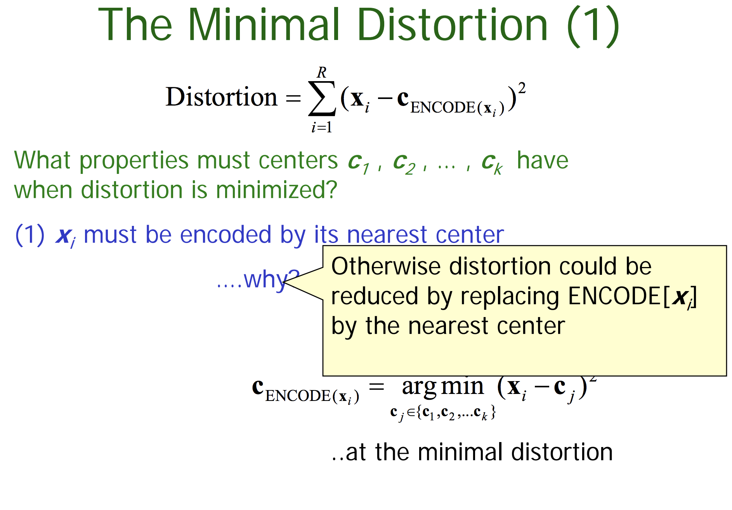

Slide 17
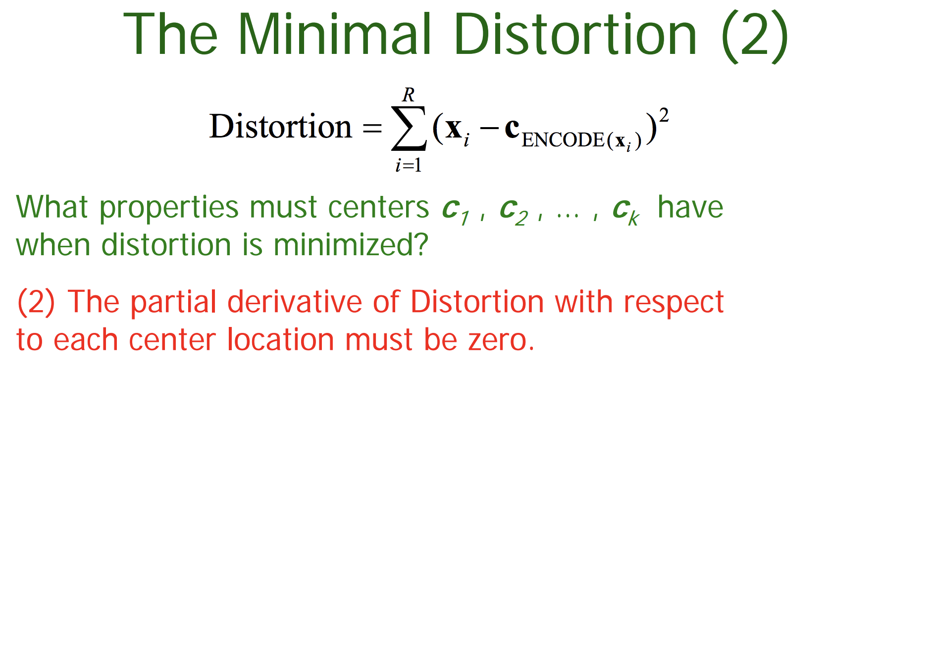

Slide 18
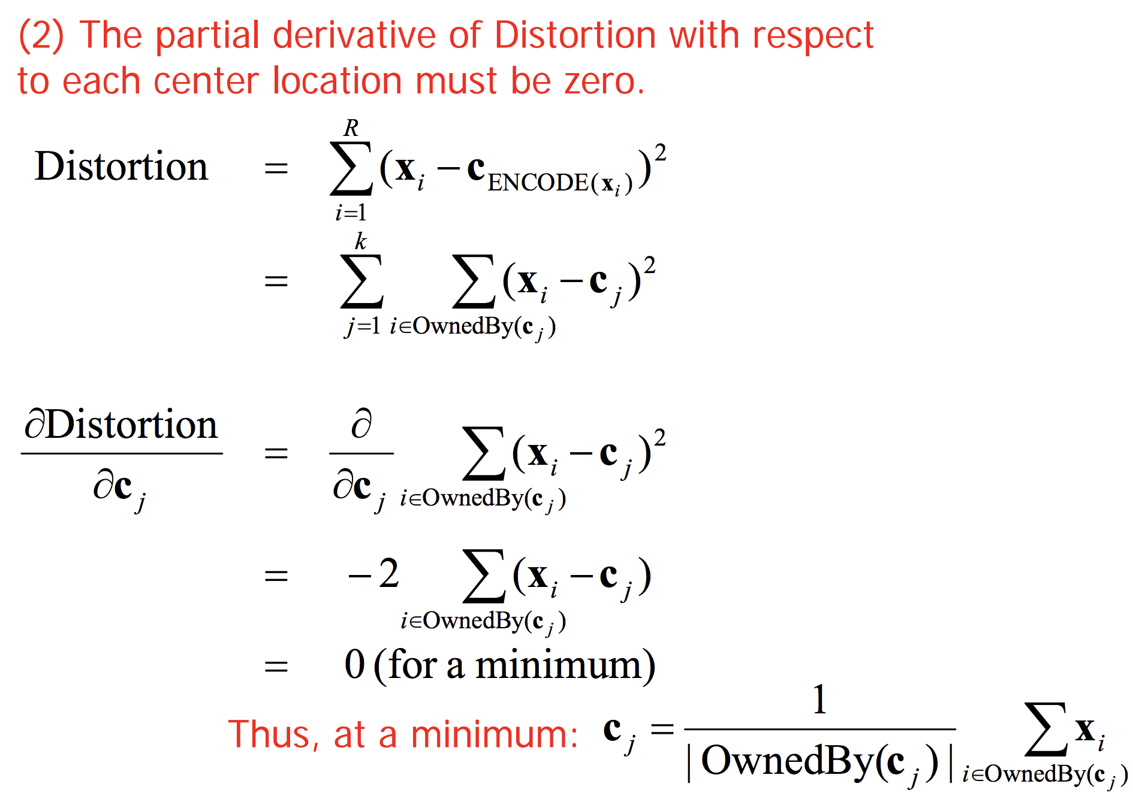

Slide 19
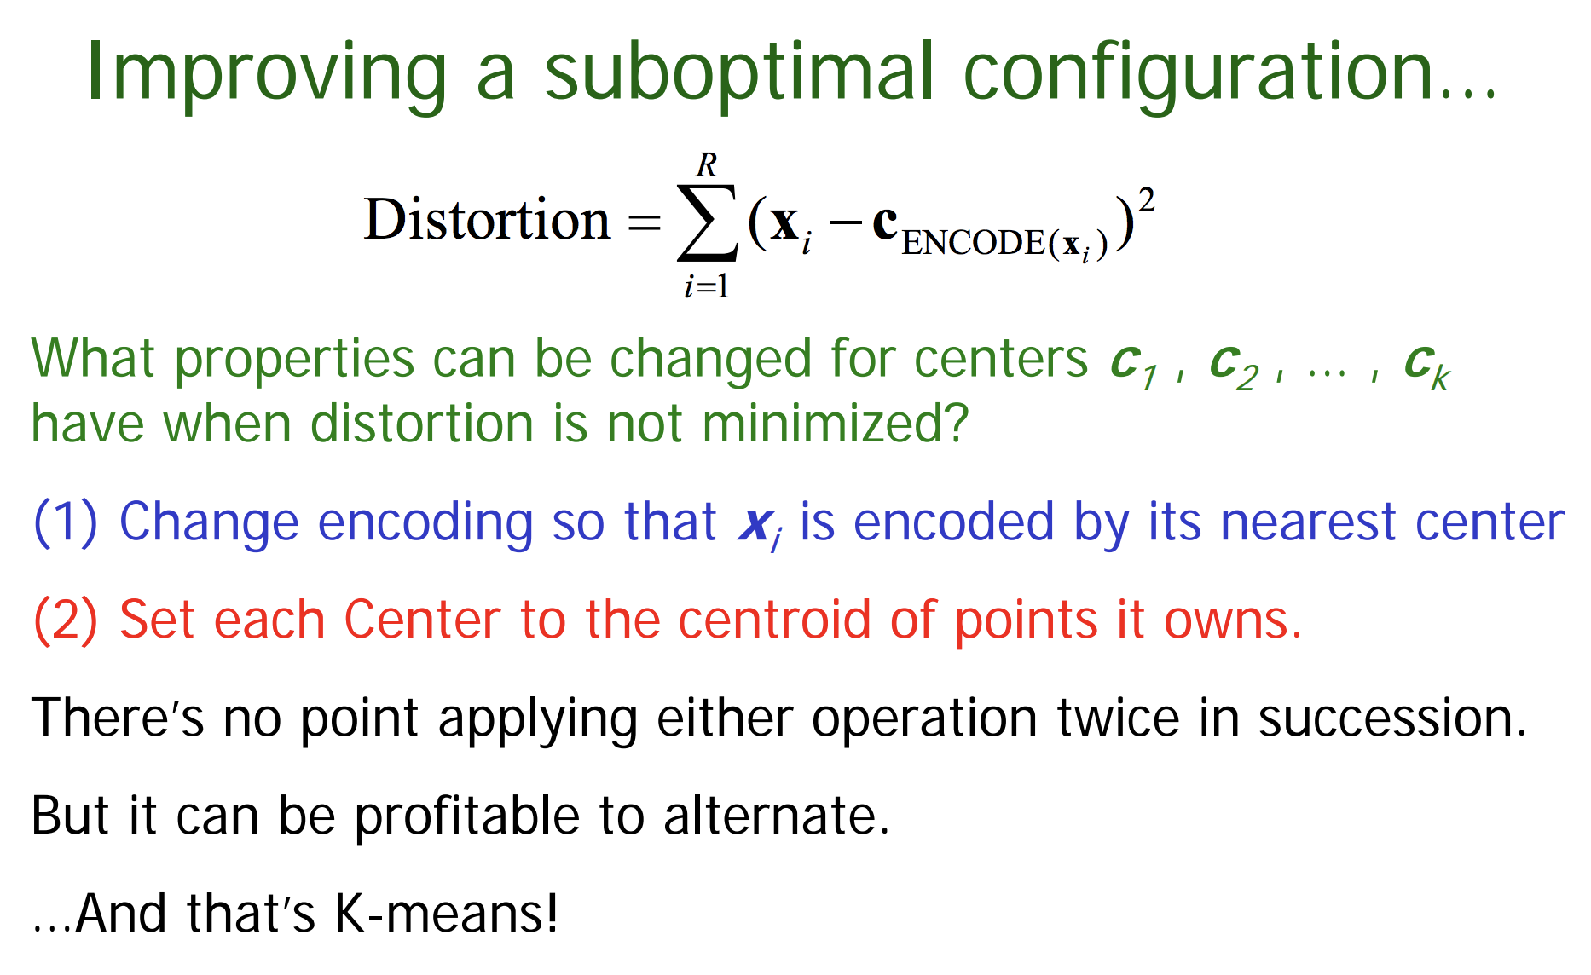

Slide 20
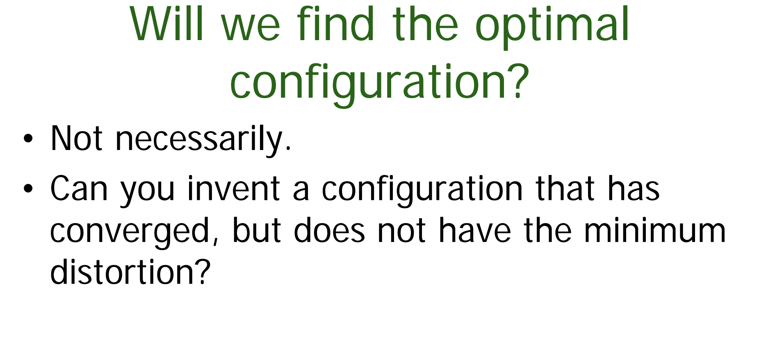

Slide 21
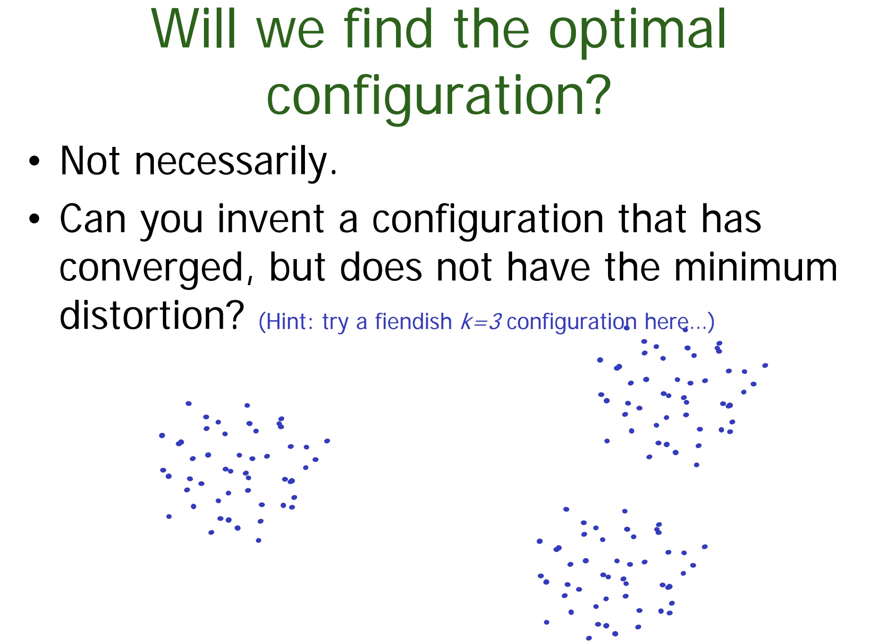

Slide 22
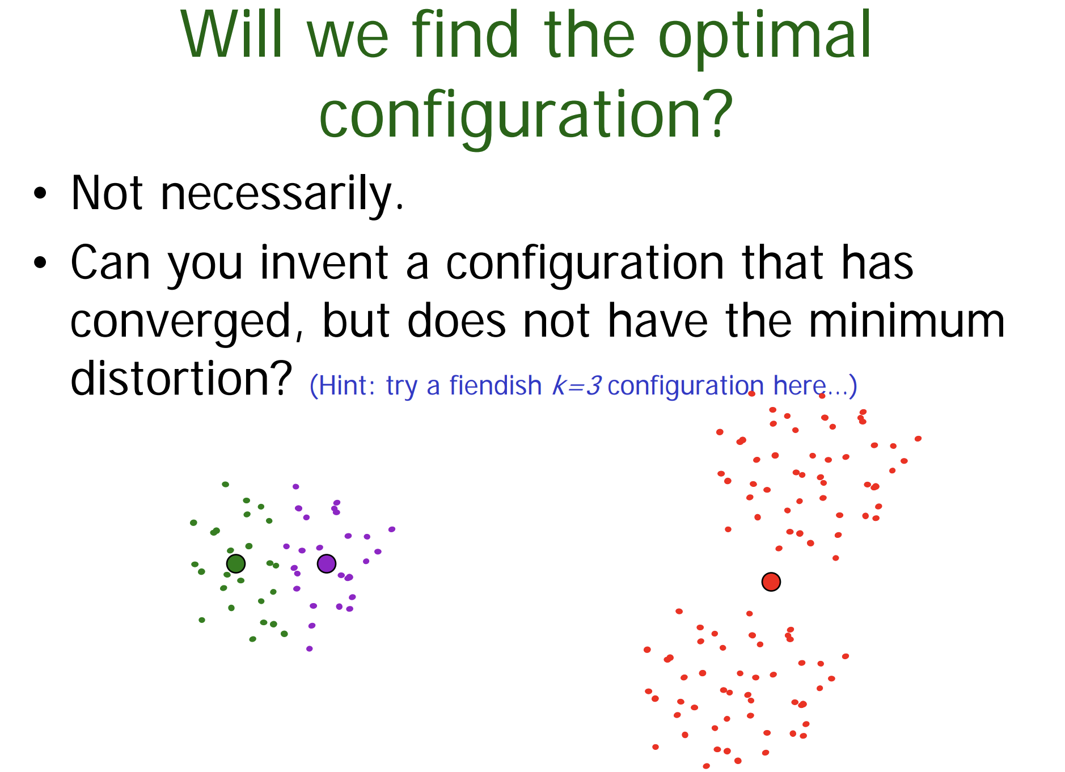

Slide 23
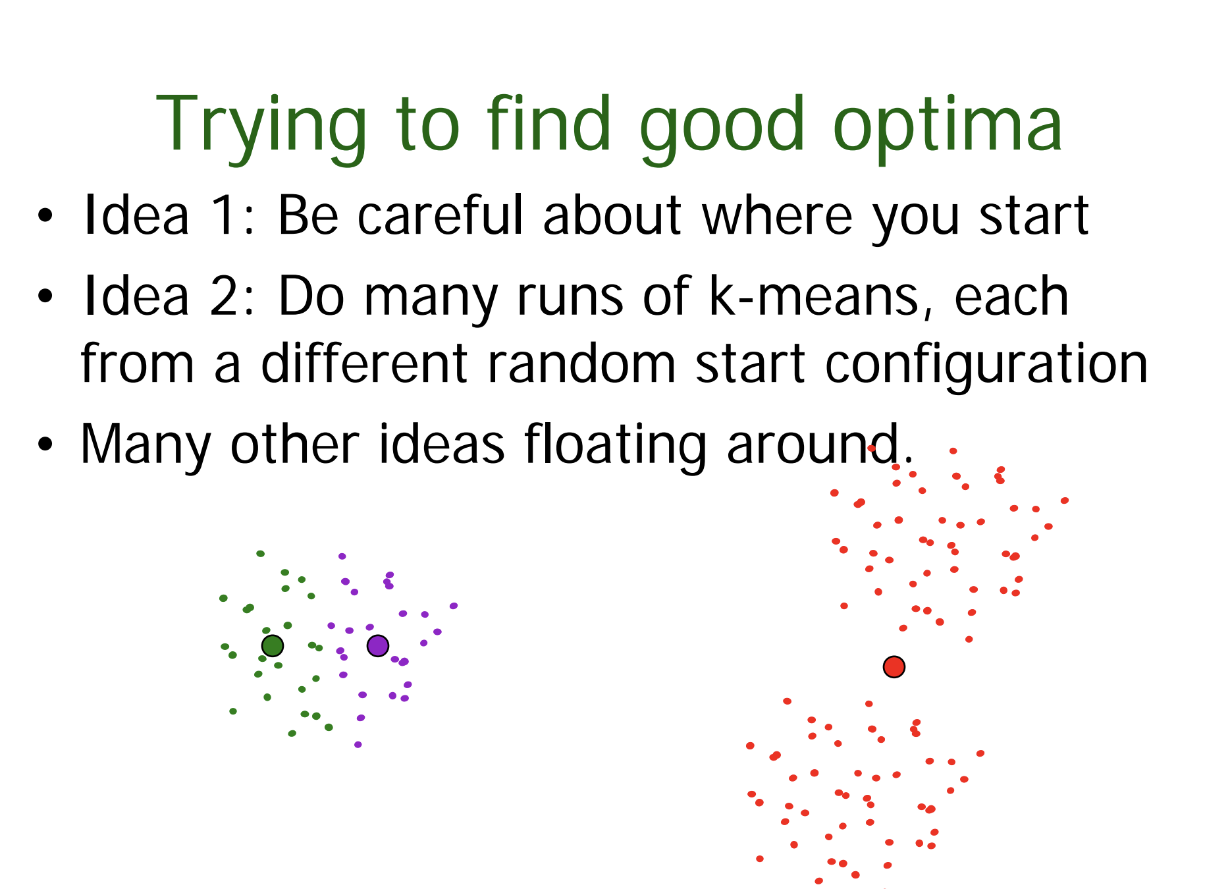

Slide 24
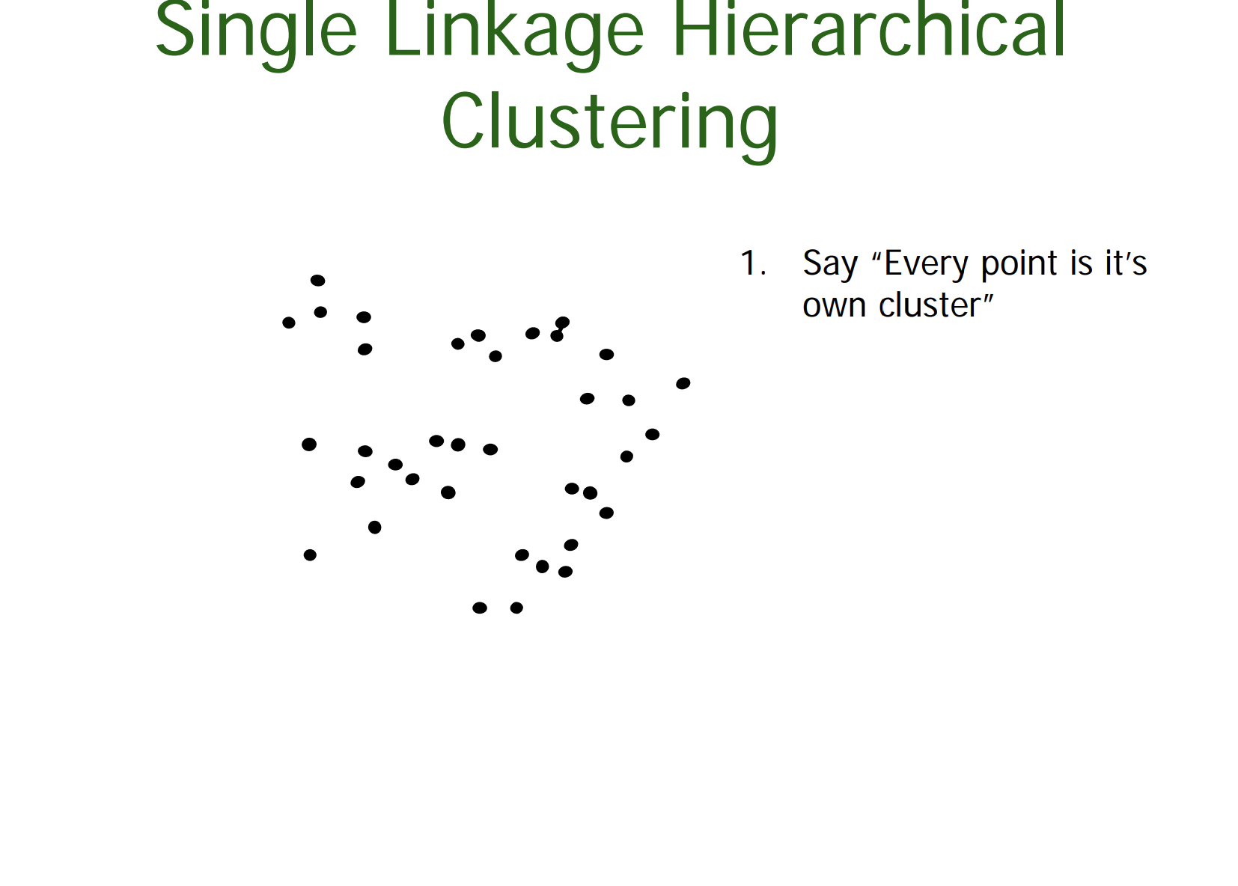

Slide 25
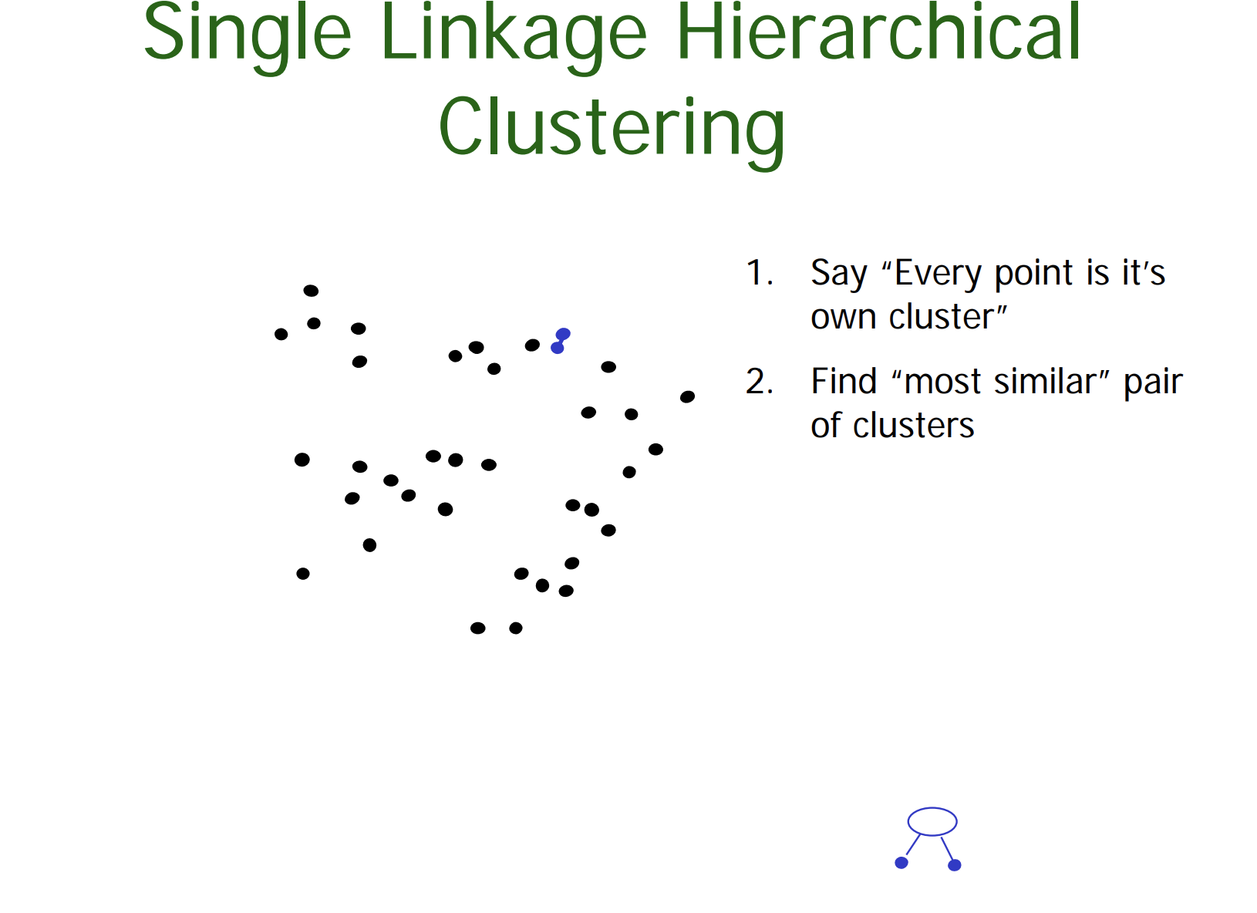

Slide 26
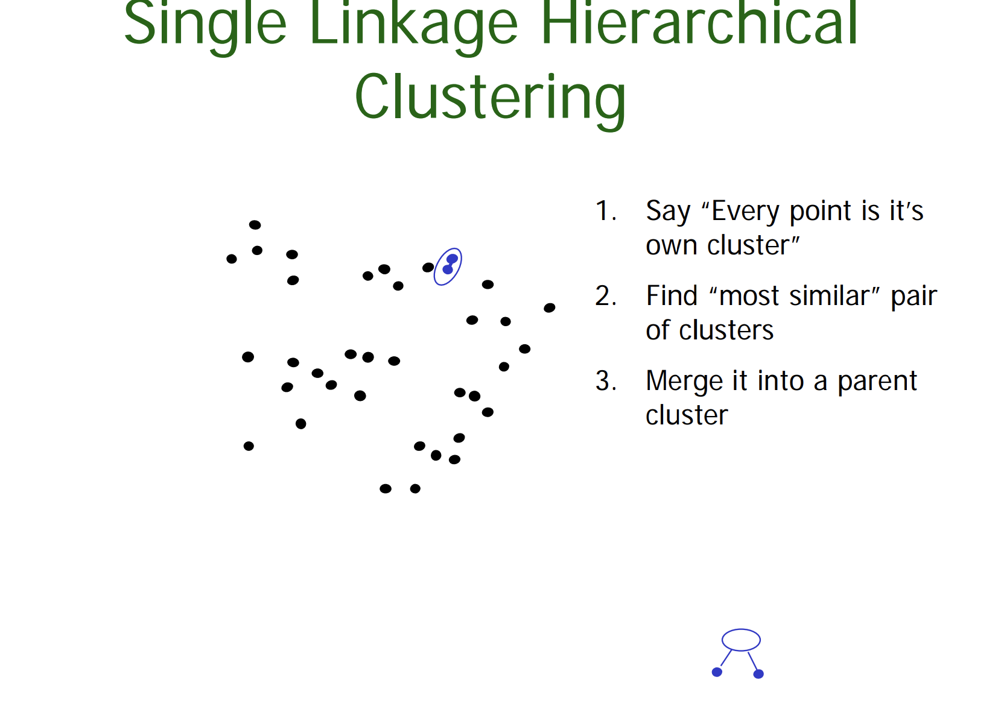

Slide 27
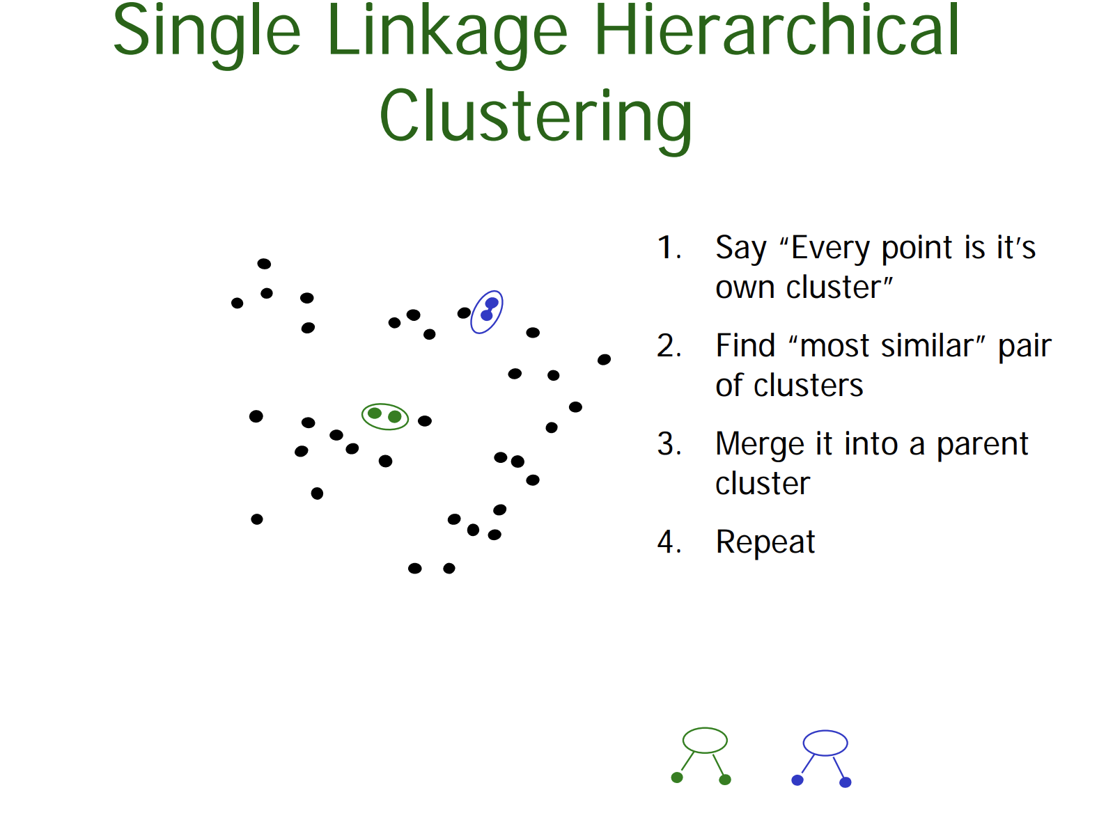

Slide 28
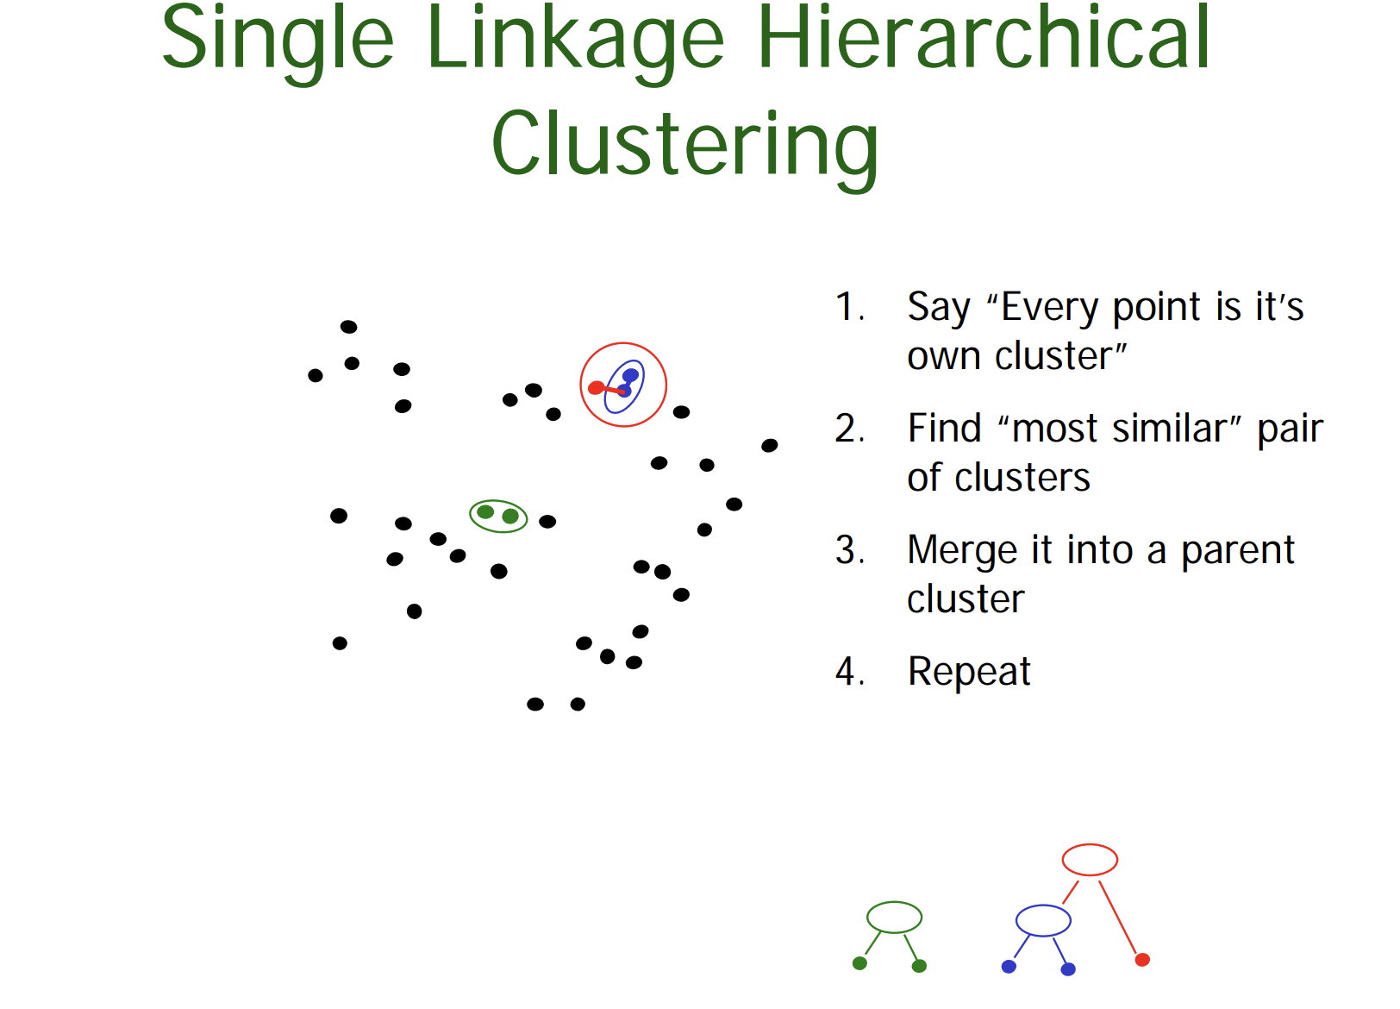

Slide 29
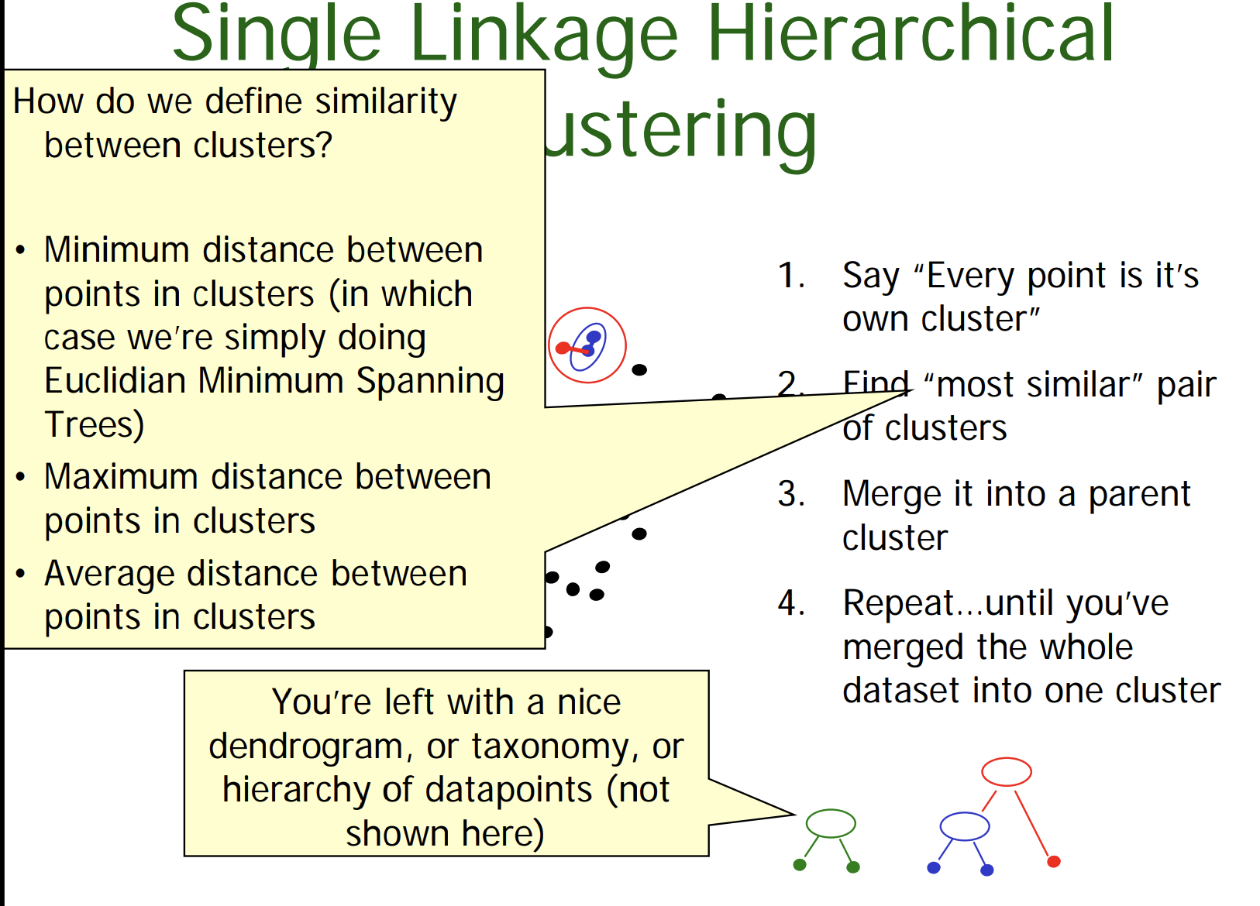

Slide 30
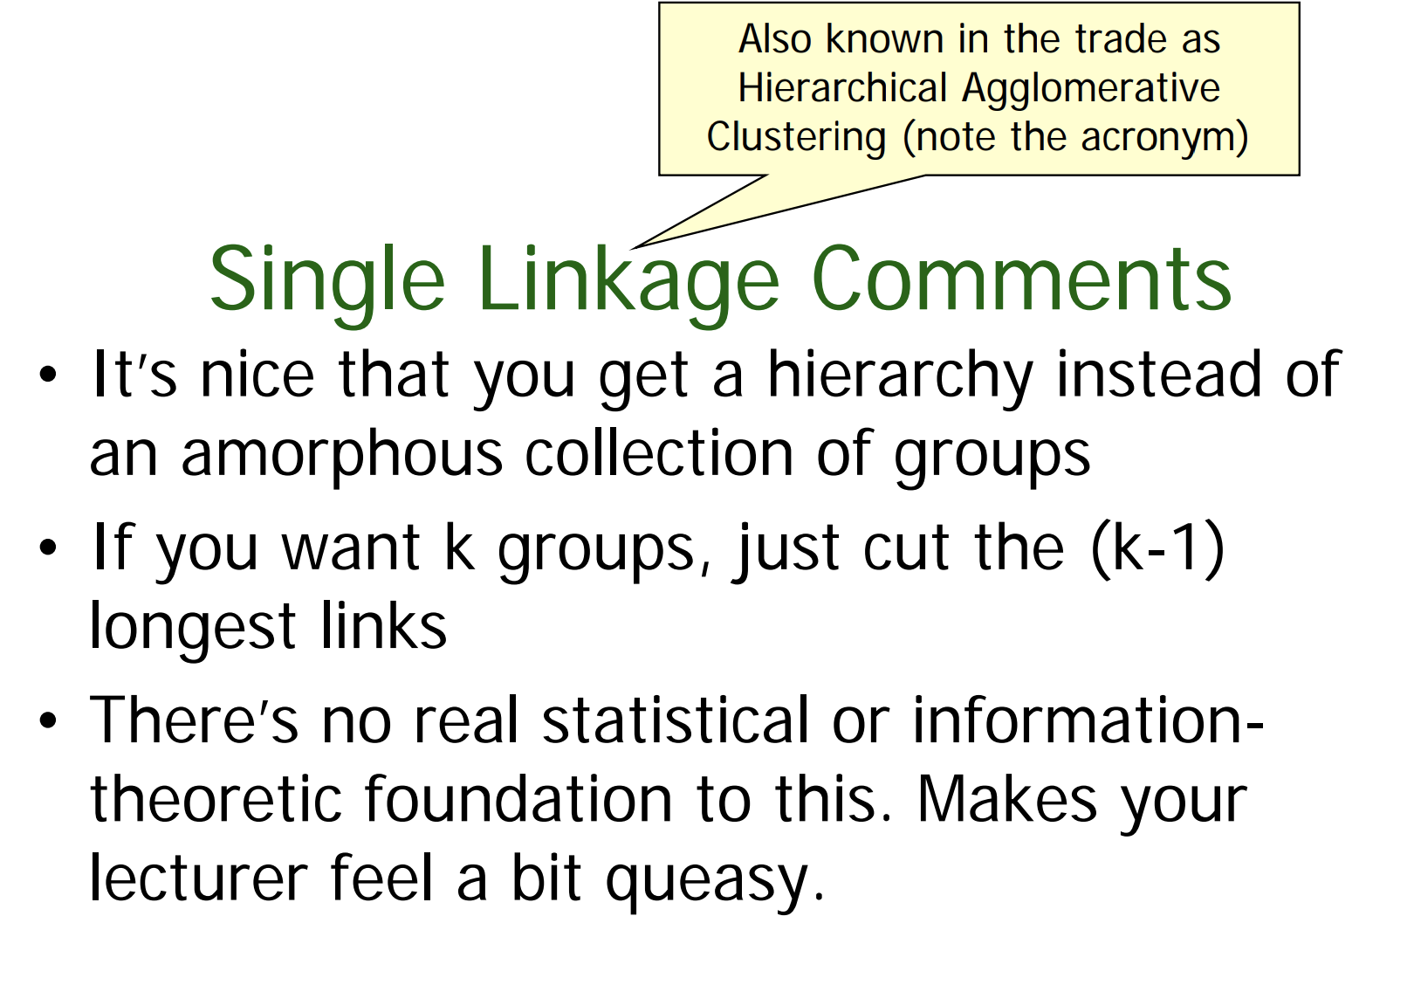

Slide 31
What you should know?
All the details of K-means
The theory behind K-means as an optimization algorithm
How K-means can get stuck
The outline of Hierarchical clustering
Be able to contrast between which problems would be relatively well/poorly suited to Kmeans vs Hierarchical clustering

Slide 32
Acknowledgements
Note to other teachers and users of these slides. Portions of these slides are provided by Andrew Anton. Here is his message:
Andrew would be delighted if you found this source material useful in giving your own lectures. Feel free to use these slides verbatim, or to modify them to fit your own needs. PowerPoint originals are available. If you make use of a significant portion of these slides in your own lecture, please include this message, or the following link to the source repository of Andrew’s tutorials: http://www.cs.cmu.edu/~awm/tutorials . Comments and corrections gratefully received.

